Slide 1





Tarlac Train Express
Daily Summary Report
Origin
Destination
Discount
Fare
Total Fare Collected
Vat 12%
Net Collection
Total Fare
Discount
Net Fare
Compute Fare
Issue Ticket
Print

Slide 2
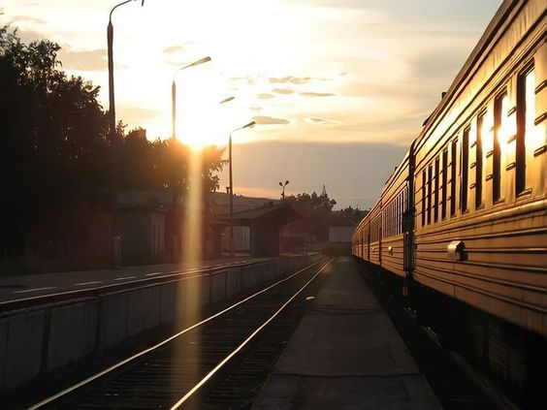

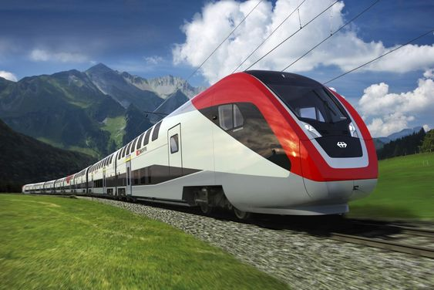
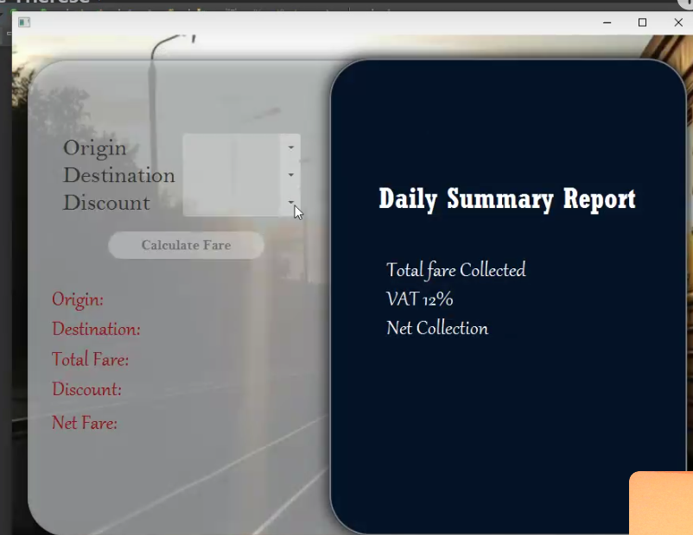




ORIGIN
DESTINATION
DISCOUNT
Bamban
Moncada
Student
Calculate Fare
ORIGIN:
DESTINATION:
TOTAL FARE:
DISCOUNT:
NET FARE:
Bamban
Moncada
180.00
144.00
36.00
Train Express

Slide 3
ORIGIN
DESTINATION
DISCOUNT
Bamban
Train Express
Daily Summary Report
Moncada
Student
TOTAL FARE COLLECTED
144.00
Calculate Fare
VAT 12%
ORIGIN:
DESTINATION:
TOTAL FARE:
DISCOUNT:
NET FARE:
126.72
Bamban
Moncada
NET COLLECTION
18.28
180.00
144.00
36.00
Issue Ticket
Print Ticket

Slide 4
ORIGIN
DESTINATION
DISCOUNT
Bamban
Train Express
Daily Summary Report
Moncada
Student
TOTAL FARE COLLECTED
144.00
Calculate Fare
VAT 12%
ORIGIN:
DESTINATION:
TOTAL FARE:
DISCOUNT:
NET FARE:
126.72
Bamban
Moncada
NET COLLECTION
18.28
180.00
144.00
36.00
Issue Ticket
Print Ticket

